Slide 1
Construction Practices

Slide 2
Coding Guideline - Principle
Client perspective
Maintainer's perspective
Notes:
test

Slide 3
Coding Guideline - Program Characteristics
Integrity
Clarity
Simplicity
  May sacrifice a certain amount of computational efficiency in order to maintain a relatively simple program
Efficiency
  Should not be obtained at the expense of clarity and simplicity.
Notes:
test

Slide 4
Coding Guideline - Program Characteristics
Modularity
Generality
Lots of little pieces
  Good software invariably has small methods and small objects.
Replaceable and movable objects
Notes:
test

Slide 5
Coding Guideline - Preferred Practices
Name types well and choose purpose instructive/intuitive operation names
Define Contract for each operation
  One operation should do one thing
  Return from a single place
Make execution structure obvious
Notes:
test

Slide 6
Coding Guideline - Preferred Practices
Handle all sort of errors
  Paranoid coding
  Error handling standards
Make code self documenting before commenting it
  Provide comments that augment not repeat program code
Notes:
test

Slide 7
Coding Guideline - Code Review
Code review is important
  Also known as Static Test
Code analysis tools help
  https://www.softwaretestinghelp.com/tools/top-40-static-code-analysis-tools/
Notes:
test

Slide 8
Exception/Error Handling - Error
Error
  Expected behaviour
  Validation fails
Have an error handling strategy
All possible errors should be externalised with error code
  Message can be changed easily if needed
Notes:
test

Slide 9
Error Handling - Exception
Exception
  Runtime behaviour
  Unhandled error
    SQLException
  Forced exception
    File handling
  Paranoid coding
    Null parameter for a method
Notes:
test

Slide 10
Error Handling - Exception
All exceptions need to be caught
  Event handling code
  Public methods
  Post/Get methods ....
No exceptions should be eaten up
  no try catch do nothing
Translate system exception to user understandable exception
Notes:
test

Slide 11
Configuration Management
Process for establishing and maintaining consistency of a product's performance, through out lifecycle
Software Configuration Management (SCM or S/W CM) is a subset Configuration Management
  Tracks and controls changes
  Establishes baseline
Notes:
test

Slide 12
Configuration Management
Configuration Item
  Items whose change needs to be tracked
    Requirement, design, code
Version control software helps here
  Git, CVS, ClearCase, PVCS, Microsoft Team Foundation Server etc
Notes:
test

Slide 13
Change Management
Change in Software is inevitable
Raised through change request
  Proper requirement base line avoids handling change as defect
Need a rigorous Change Management process
Notes:
test

Slide 14
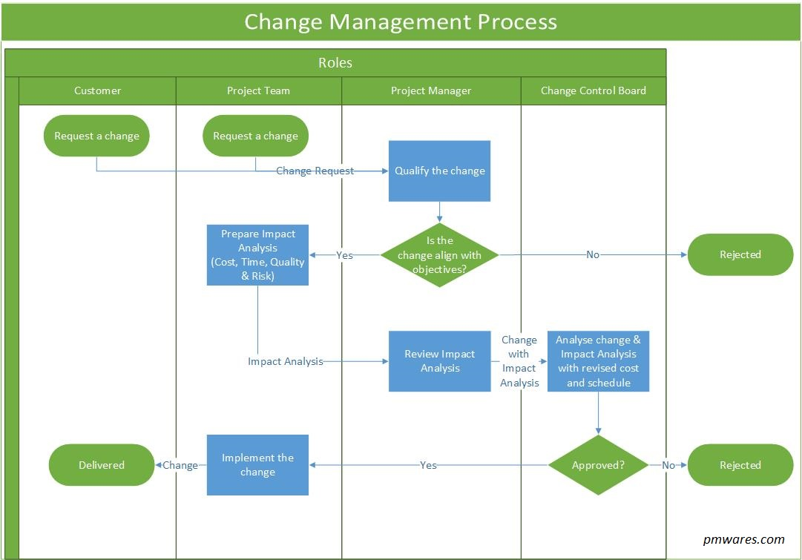
Change Management - Process Outline*
*Varies with organization
Notes:
test

Slide 15
Change Management
Change log is maintained to track life cycle
  CR Id
  Raise Date
  Description
  Attachment (if any)
  Status
  Delivery date (if applicable)
Notes:
test

